Slide 1

GAP 5503
Engine Construction
Lecture 6
A2 Engine Architecture
Assignment 2 Explained (in-class)

Slide 2
Engine Architecture Progression
Assignment 1
  Getting used to C++ / API
  All functionality in main.cpp
Assignment 2
  Separation of functionality into classes
  Write our own Vec2 class for 2D game math
  Appearance of ECS classes
  EntityManager handles all Entity data
  ECS Systems functionality in Game.h functions

Slide 3
A2 Engine Architecture
GameEngine
  >Systems
  >EntityManager
    >Entity
      >Component

Slide 4
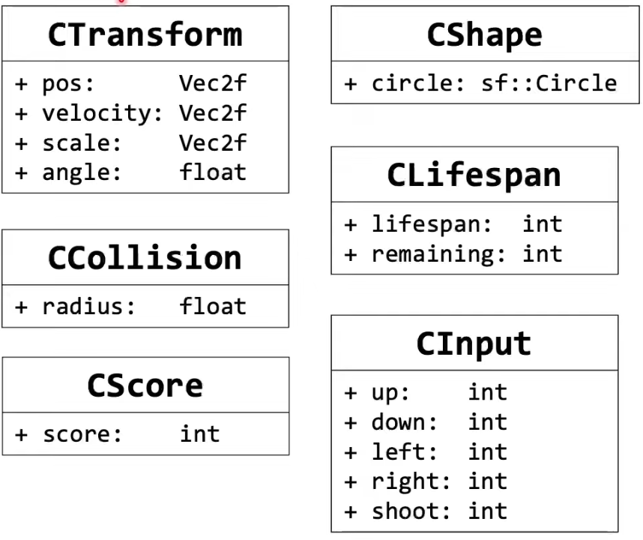
Components
Pure Data
Stored in Entity
Each Component is its own class

Slide 5
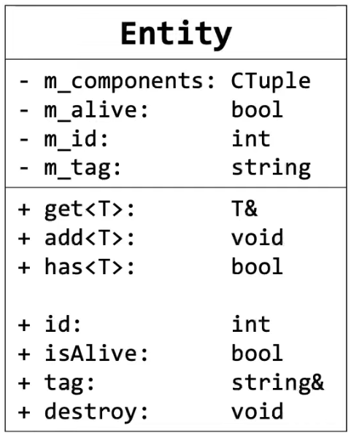
Entity
Entity = Game Object
Stores Component Tuple
Tag = Entity “type”
Active = Alive or Dead
ID = Integer Identifier

Slide 6
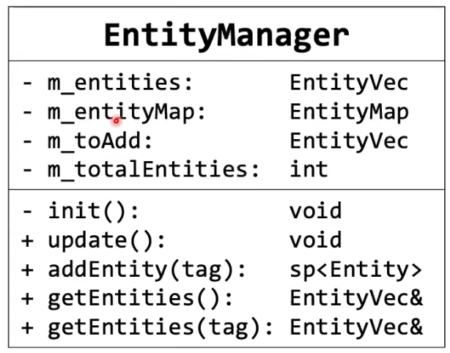
EntityManager
Entity “Factory” Class
Delayed Entity Add()
  No Iterator Invalidation
Secondary Map from tag -> entity
  Trade storage for convenience / run time
Can do other book-keeping like memory management

Slide 7
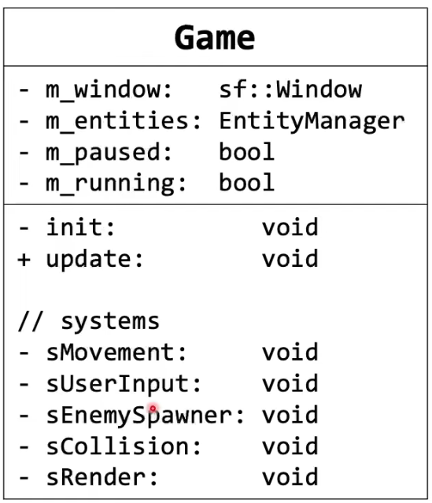
Game
Top-Level Game Object
Holds all game data
All game system functions
All gameplay code

Slide 8
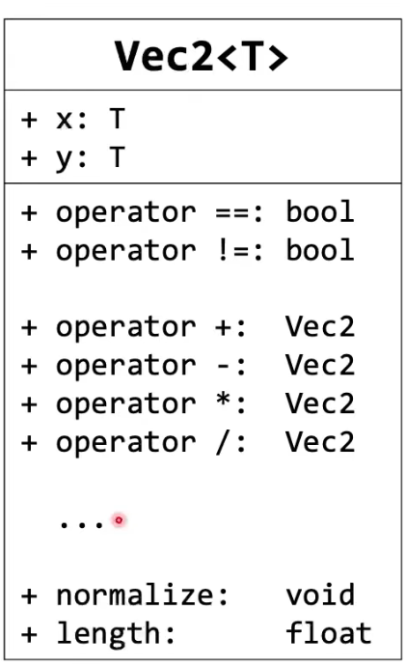
Vec2
2D Math Structure
  See previous lecture
Templated Class
  T = (x, y) variable type
using Vec2f = Vec2<float>;

Slide 9
What can this engine do ?
Create game objects as Entity instances
Add Component data to Entities
Implement game play via Systems
  Also, handle user input
Pause game play / exit game
Can init / load configuration from file

Slide 10
What are the limitations ?
Can only display one “scene”
Can NOT load texture / sounds assets
Can NOT display textured animations
Does not have any menu / interface

Slide 11
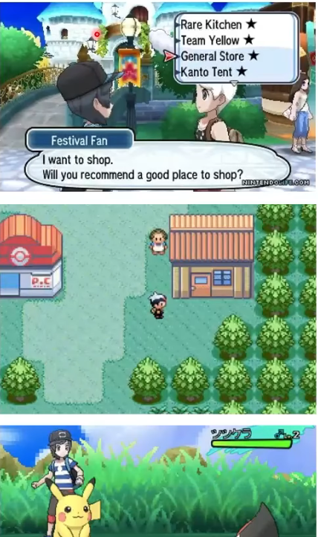
Game Scene
A game can contain many different “scenes” that have very different logic / controls
Example: RPG Games
  Menu / Text / Dialogue Scene
  World-Map Scene
  Combat / Battle Scene
How can our architecture allow for different game states ?

Slide 12

Circles
Circles drawn on screen aren’t true math circles
Can’t draw infinite points
Decide on some number of points to draw

Slide 13
SFML Circles
sf::CircleShape c(r, p);
  r = radius
  P = point count
Example: p = 128

Slide 14
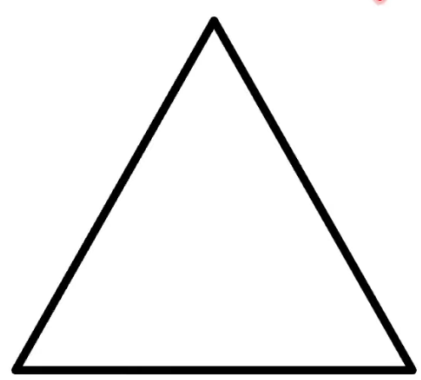
SFML Circles
sf::CircleShape c(r, p);
  r = radius
  P = point count
c.setPointCount(3);

Slide 15
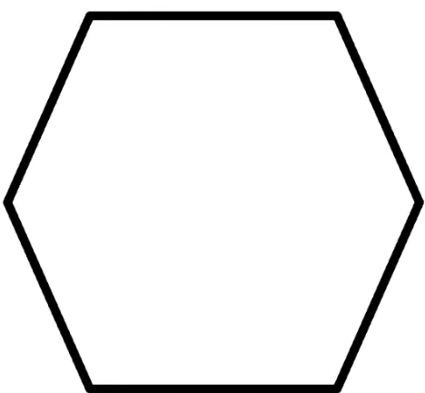
SFML Circles
sf::CircleShape c(r, p);
  r = radius
  P = point count
c.setPointCount(6);

Slide 16

SFML Circles
sf::CircleShape c(r, p);
  r = radius
  P = point count
c.setPointCount(6);
c.setOutlineThickness(20);

Slide 17

SFML Circles
sf::CircleShape c(r, p);
  r = radius
  P = point count
c.setPointCount(6);
c.setOutlineThickness(20);
c.setOutlineColor(red);

Slide 18
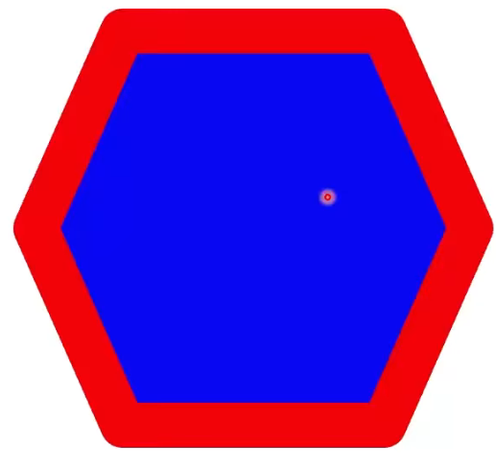
SFML Circles
sf::CircleShape c(r, p);
  r = radius
  P = point count
c.setPointCount(6);
c.setOutlineThickness(20);
c.setOutlineColor(red);
c.setFillColor(blue);

Slide 19
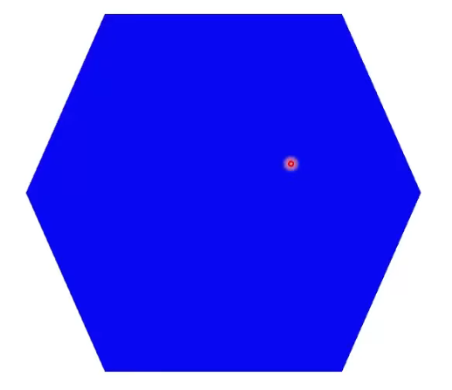
SFML Circles
sf::CircleShape c(r, p);
  r = radius
  P = point count
c.setPointCount(6);
c.setOutlineThickness(0);
c.setOutlineColor(red);
c.setFillColor(blue);

Slide 20

SFML Circles
sf::CircleShape c(r, p);
  r = radius
  P = point count
c.setOrigin({0,0})
  window.draw(c) will draw the origin at c’s position

Slide 21
SFML Circles
sf::CircleShape c(r, p);
  r = radius
  P = point count
c.setOrigin({r,r})
  We want circle position to represent its center
  Collision math easier

Slide 22
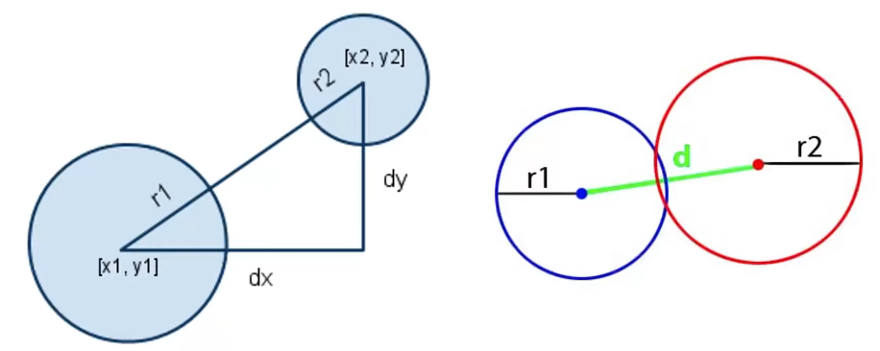
Circle Collisions

Slide 23
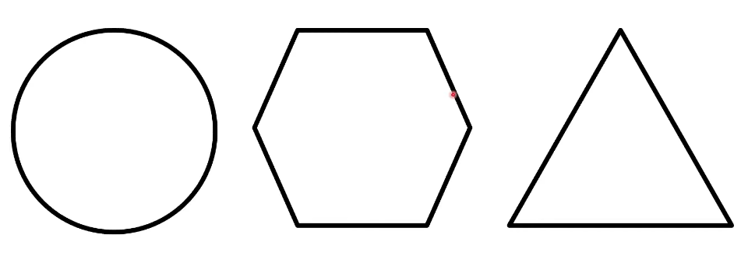
Shape Collisions

Slide 24
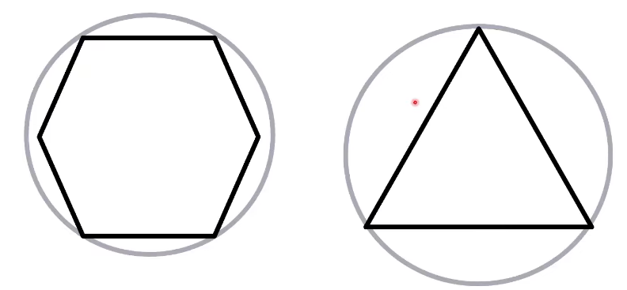
Shape Collisions

Slide 25
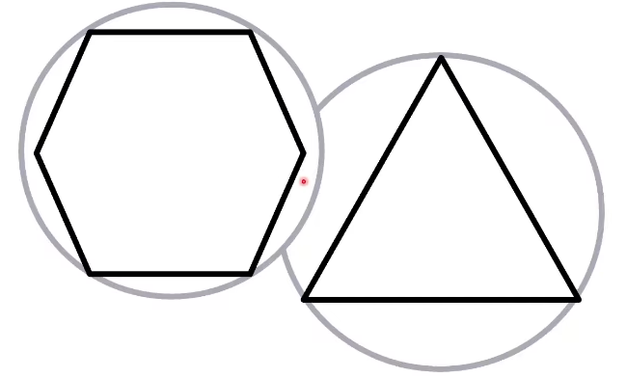
Shape Collisions

Slide 26
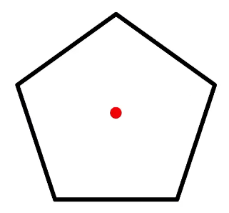
Small Enemy Spawning

Slide 27
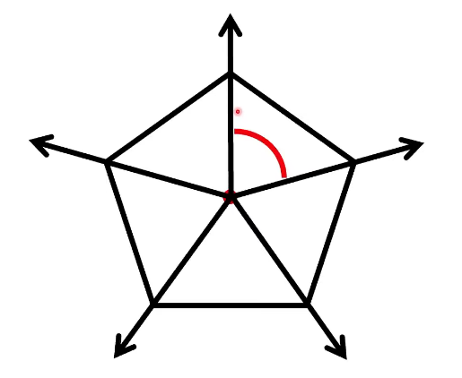
Small Enemy Spawning

Slide 28
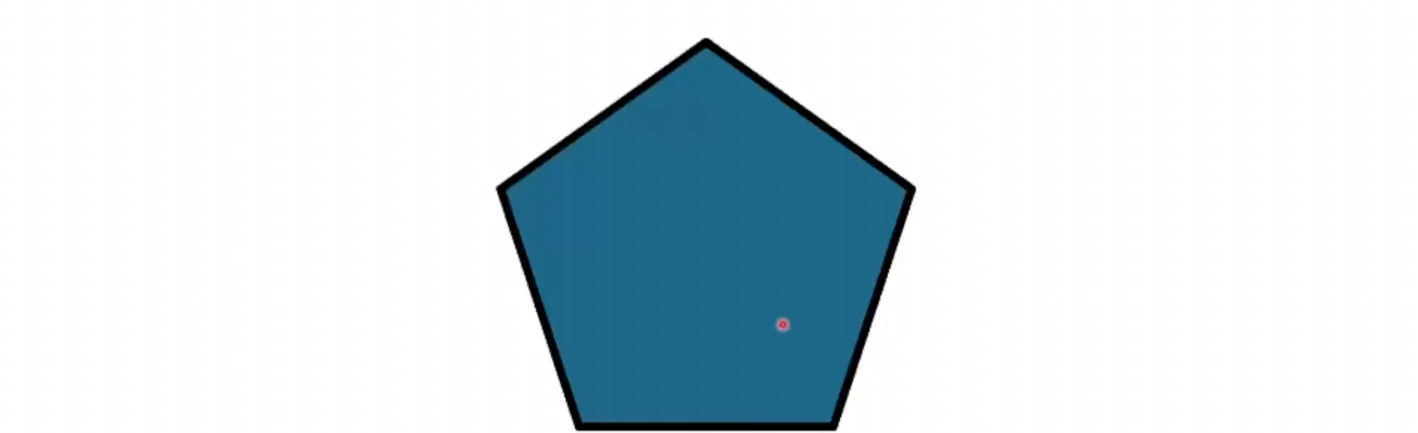
Small Enemy Spawning

